Slide 1
Reproduction of protists

Slide 3
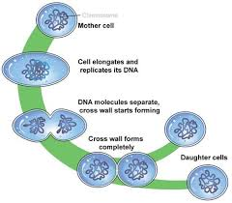
asexual reproduction
Define:
One parent reproduces without a sperm and an egg
Benefit- Quickly creates new organisms

Slide 4
Binary Fission
How does it work?
What does it look like?
the reproduction of a living prokaryotic cell by dividing the cell into two parts, each with the potential to grow to the size of the original.
https://www.youtube.com/watch?v=X7Qz9oc4DsA

Slide 5
Check for understanding
If produced asexually, how much of the parent’s genetic material will the new organism have?
(write answer)

Slide 6
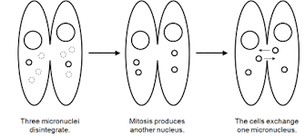
sexual reproduction
Define:
Two parents reproduces with a sperm and an egg
Benefit- Diversity of Characteristics

Slide 7
Conjugation
How does it work?
What does it look like?
A process in which two organisms exchange genetic material
Example: Paramecium
https://www.youtube.com/watch?v=d3MqPerFU7I

Slide 8
check for UNDERSTNDING
Consider under what conditions each type of reproduction -- asexual and sexual -- might be the most effective strategy for passing on one's genes and avoiding extinction.

