Slide 1
Biotic vs Abiotic

Slide 2
Think and INK

Slide 3
biotic
Define- Presence of life or living organisms

Slide 4
Abiotic
Define- Absence of life or living organisms

Slide 5
ACTIVITY
Living and Non-Living

Slide 6
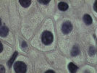
All Living things have…
1)Cells
Cell-A cell is the smallest “unit of life”

Slide 7
Living Things…
2) Grow and Develop
Grow -addition of mass to an organism
Develop the process that occurs in an organism's life that results in a more complex organism.

Slide 8
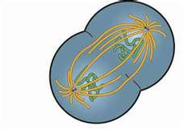
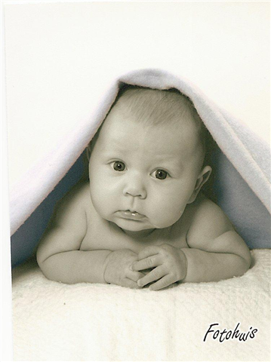
All living things…
3) Reproduce

Slide 9
ALL Living things…
4) Obtain and use energy
Plants get energy from the sunlight, through a process called photosynthesis
Humans (and other animals) get energy from the food we eat

Slide 10
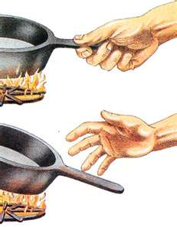
ALL LIVING THINGS…
5)Respond to stimuli
Stimuli: Anything from the environment that causes some sort of reaction, such as temperature, light, sound, and other factors that cause living things to respond.

