Slide 1
Introduction to Cells

Slide 2
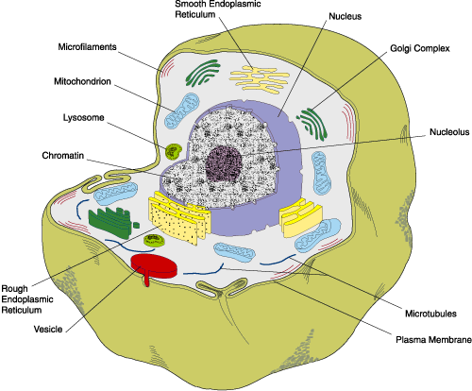
What is a Cell?
The cell is the basic unit of structure and function in living things.

Slide 3
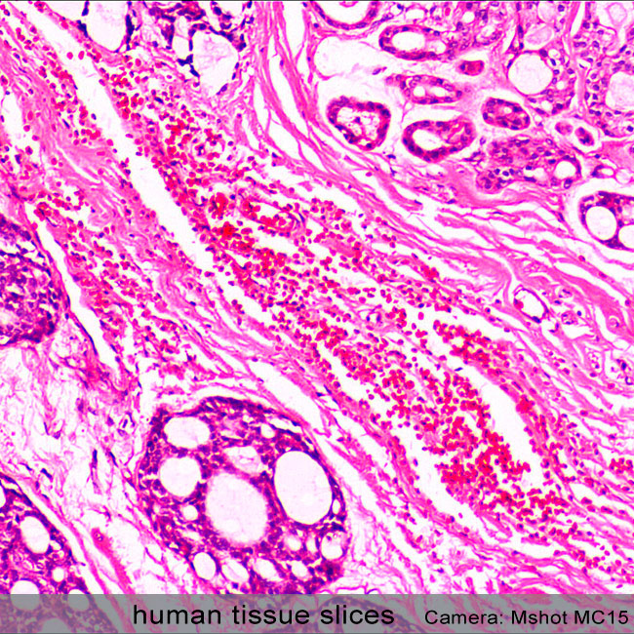
What do CELLS FORM?
A tissue is a group of similar cells working together to perform a specific function.

Slide 4
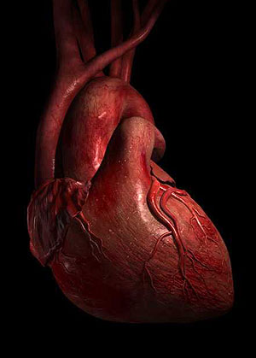
wHAT DO TISSUES FORM?
An organ is a group of different tissues that work together to perform a complex function.

Slide 5
Check For Understanding
What is the basic unit of structure and function in living things?
Organisms
Organs
Cells
Tissues

Slide 6
Check For Understanding
Which statement about cells and tissues is correct?
Tissues are bigger than cells, because tissues make up cells.
Cells are bigger than tissues, because tissues make up cells.
Tissues are bigger than cells, because cells make up tissues.
Cells are bigger than tissues, because cells make up tissues.

Slide 7
Levels of Organization
Cells
Tissues
Organs
Organ Systems
Organism

Slide 8
Cell Theory
1) all living things are made of one or more cells
2)the cell is the smallest unit of life
3)All new cells come from preexisting cells

Slide 9
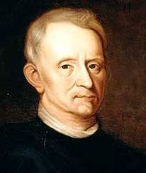
rOBERT hOOKE
1660’s – Robert Hooke discovered the cell
He looked at cork under the microscope (30x)
He noticed little compartments, which he named after
the little rooms that monks lived in…”Cells”

Slide 10
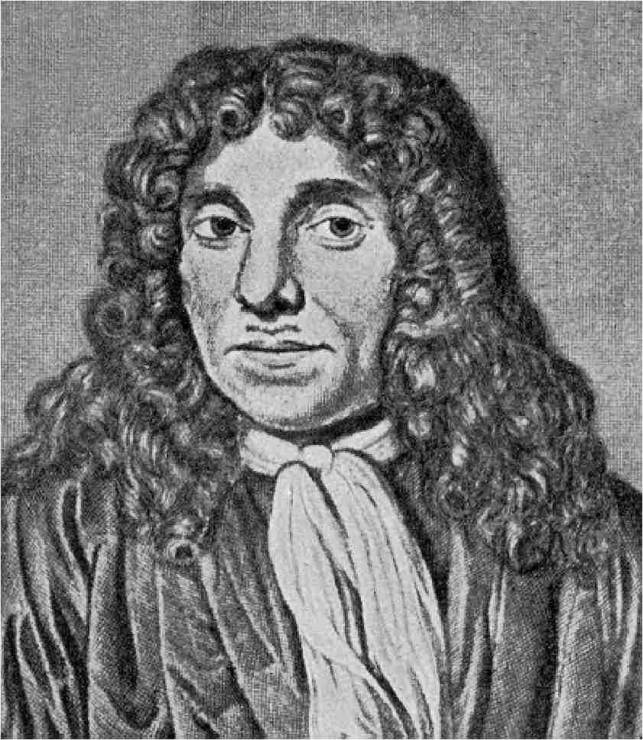
Anton von Leeuwenhoek
1670’s – Anton von Leeuwenhoek described
microorganisms in pond water
He noticed that the water was full of moving living things

Slide 11
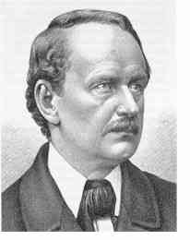
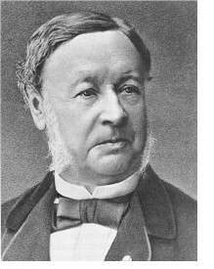
How did the cell theory come to be?
They discovered that the cell was the basic unit of life and that all living things are composed of cells

